Slide 1
Unit 202: Principles of electrical science
Resistors in series

Slide 2
Resistors in series
R_{T} = R₁ + R₂ + R₃

Slide 3
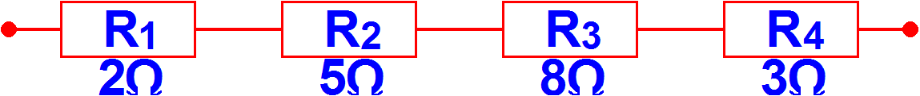
Example 1
Calculate the total resistance of the circuit shown below:

Slide 4
Example 1
Calculate the total resistance of the circuit shown below:
R_{T} | = | R₁ + R₂ + R₃ + R₄
Put some figures in:
 | = | 2 + 5 + 8 + 3
Calculate through to give:
 | = | 18Ω

Slide 5
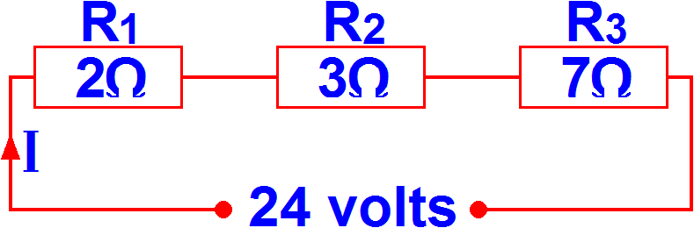
Example 2
Calculate the current that will flow in the circuit shown below:
R_{T} | = | R₁ + R₂ + R₃
Put some figures in:
 | = | 2 + 3 + 7
Calculate through to give:
 | = | 2A

Slide 6
Example 2
Calculate the current that will flow in the circuit shown below:

Slide 7
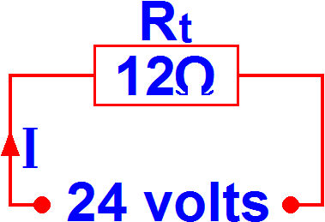
Example 2
Equivalent circuit:
I | = | V R
 | = | 24 12
 | = | 2A

Slide 8
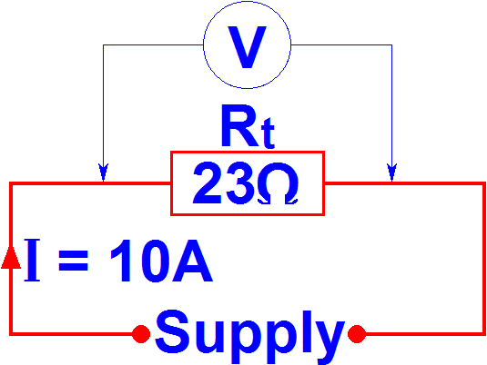
Example 3
What potential is produced across a resistance of 23Ω if a current of 10 amps is flowing through it?
V | = | I × R
Put some figures in:
 | = | 10 × 23
Calculate through to give:
 | = | 230 volts

Slide 9
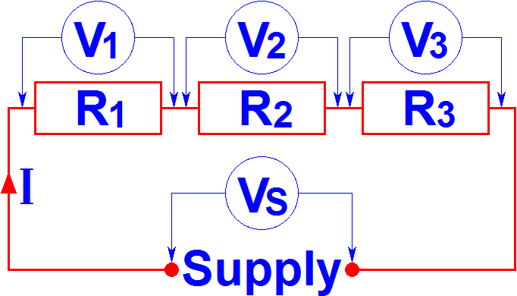
Kirchoff’s Voltage law
The algebraic sum of the voltages around a circuit is equal to zero (or the supply voltage).
V_{S} = V₁ + V₂ + V₃

Slide 10
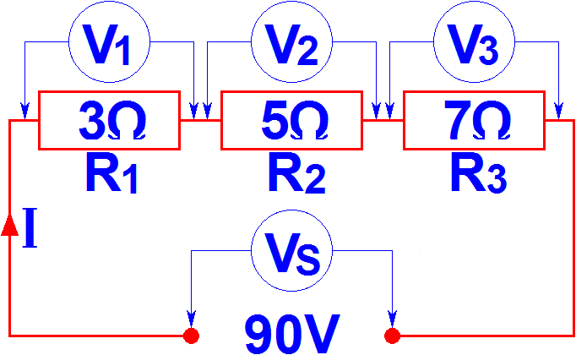
Example 4
Calculate V₁, V₂, V₃, hence, proving Kirchhoff's Voltage law.
R_{T} | = | R₁ + R₂ + R₃
 | = | 3 + 5 + 7
 | = | 15Ω
I | = | V R
 | = | 90 15
 | = | 6A

Slide 11
Example 4
Resistor 1
Resistor 2
Resistor 3
V₁ | = | I × R₁
V₂ | = | I × R₂
V₃ | = | I × R₃
 | = | 6 × 3
 | = | 6 × 5
 | = | 6 × 7
 | = | 18V
 | = | 30V
 | = | 42V
V_{T} | = | V₁ + V₂ + V₃
 | = | 18 + 30 + 42
 | = | 90 volts - Kirchhoff’s law is proved

Slide 13
Unit 202: Principles of electrical science
The End

